Slide 1
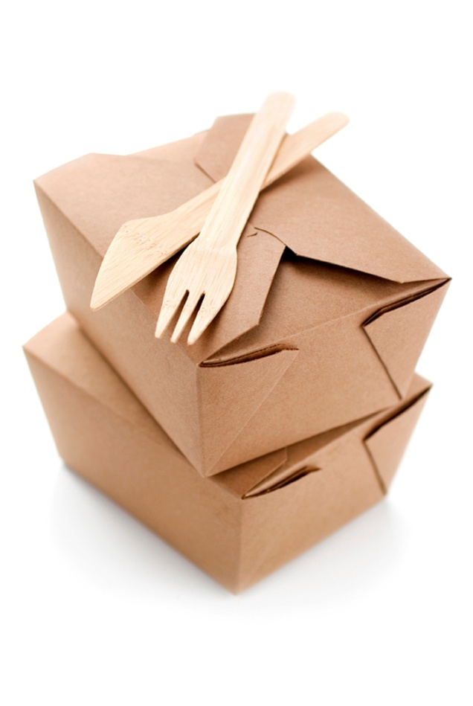
APPLY CATERING CONTROL PRINCIPLES AND PROCEDURES
D1.HCC.CL2.01
Notes:
Trainer to welcome students to the class
Introduce self and state qualification to teach this unit
Give overview of qualifications and describe industry experience

Slide 2
Apply catering control principles and procedures
Assessment for this Unit may include:
Oral questions
Written questions
Work projects
Workplace observation of practical skills
Practical exercises
Formal report from employer/supervisor
Notes:
Trainer to Advise:
Trainer advises students that assessment for this Unit may take several forms all of which are aimed at verifying they have achieved competency for the Unit as required.
Trainer indicates to students the methods of assessment that will be applied to them for this Unit.

Slide 3

Apply catering control principles and procedures
This unit comprises two elements:
Apply catering control principles and procedures
Minimise wastage
Notes:
Trainer to advise:
Trainer advises students this Unit comprises two elements, as listed on the slide explaining:
Each Element comprises a number of Performance Criteria which will be identified throughout the class and explained in detail
Students can obtain more detail from their Trainee Manual
The course presents advice and information but where their workplace requirements differ to what is presented, the workplace practices and standards must be observed.

Slide 4
Apply catering control principles and procedures
Element 1: Apply catering control principles and procedures:
Identify the range of catering products used within the enterprise
Use requisition/portion control effectively
Use standard recipes correctly
Implement ordering and stock rotation practices
Use optimum storage conditions
Notes:
Trainer to advise:
Trainer to relate performance criteria to element 1
Performance criteria is the process by which the students training match the learning element
The element is the skill
To assess competency in the skill; the performance criteria is used to outline activities that can be used to assess competency.
The trainer should relate how the performance criteria is related to the element
To be able to Apply catering control principles and procedures the students must be able to; Apply catering control principles and procedures
The student should be able to
Identify the range of catering products used within the enterprise
Use requisition/portion control effectively
Use standard recipes correctly
Implement ordering and stock rotation practices
Use optimum storage conditions

Slide 5
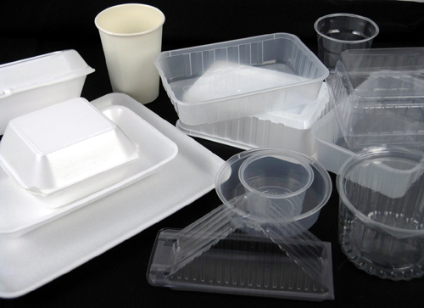
Apply catering control principles and procedures
Identify the range of catering products used within the enterprise:
Catering Products
Foods
Paper goods
Chemicals
Equipment
Consumables
Notes:
Trainer to advise:
Catering enterprises need to have more than food to operate a business
A place for preparing the product: Kitchen
A place for selling the product made: Restaurant or outside eating area
Also required food; paper and plastic goods; cleaning chemicals; equipment both in kitchen, front of house and also cleaning and garbage disposal for both areas.
Many resources are in the area of added on costs. Consumables like serviettes and take away coffee cups, cleaning chemicals, plastic wrap and aluminum foil.
All costs need to be looked at and accounted. Electricity and gas. How much does it cost to operate a freezer?

Slide 6
Apply catering control principles and procedures
Identify the range of catering products used within the enterprise:
Food Costs
Purchased weight
Usable weight
Notes:
Trainer to advise:
The amount of food in a recipe may be the amount required.
After peeling and trimming 1 kilo of carrot and cutting to size; do you have 1 kilo of carrot left? NO!
What is the true cost of the carrot being used. There is usually 8-10% weight loss when cleaning and peeling carrots.
So the remaining carrot may only be 900gm. After cutting to size you may be left with 750 gm
750 gm of carrot cut to specific size result in a change of cost for the amount of usable carrot.
If the carrots were purchased for $2.50 a kilo then peeled, cleaned and trimmed and the resulting end weight is 750gm, this then make the prepared carrots worth $3.34 per kilo. This does not include the cost of the labour to prepare the carrots.
Just the cost of the carrots.

Slide 7
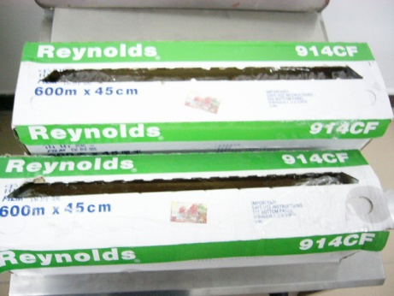
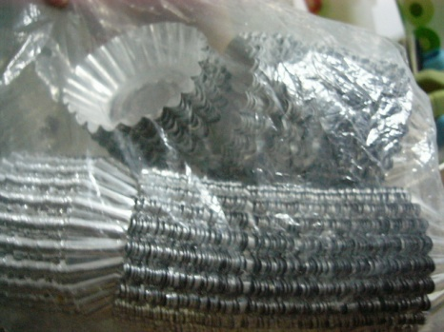
Apply catering control principles and procedures
Identify the range of catering products used within the enterprise:
Consumable costs
Consumables in Kitchens
Plastic wrap
Aluminum Foil
Baking parchment
Not necessarily in recipes but required to complete menu items.
Notes:
Trainer to advise:
The amount of consumables required is hard to measure but the cost of supplying can be a significant amount when working in larger premises.
Usage needs to be accounted against the amount revenue that is taken from the production from that area of use.

Slide 8

Apply catering control principles and procedures
Use requisition and portion control effectively:
Order only what is required - plus?
10% 5%
The larger the function, the lower the %
Notes:
Trainer to advise:
Ordering food for a catering establishments is difficult. It is not a perfect science.
You can have a Standard recipe that states a set amount of food BUT??
The BUTs is about replacing food that is
Ruined before it is cooked
Burnt in the cooking process
Plate of food is dropped before it is served to the customer
Many things may cause the amount of food that is in the Standard Recipe to be incorrect; there is a shortfall.
Number 1 rule: never run out of food until the last customer is served
So standard practice may be for 50 people order enough food for 55 plates
200 people:? Order enough food for 215 plates
The costs for this fail safe process would allow for the extra food costs
In a la carte restaurant service it is more the case when food for a particular dish is no longer available then it is taken off the menu. At least these customers will have alternative dishes to choose from.

Slide 9
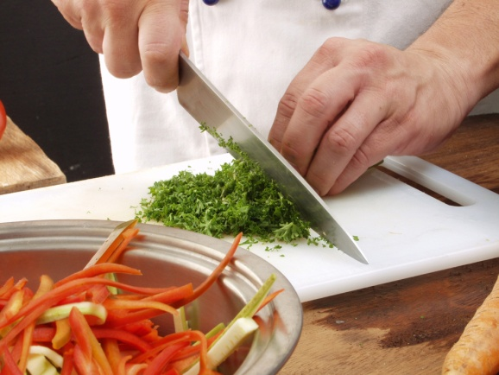
Apply catering control principles and procedures
Use requisition and portion control effectively:
Allow for mishaps
Manage for positive outcomes
Maximise higher profit margins on every menu items
Notes:
Trainer to advise:
Ordering food for a catering establishments is difficult. It is not a perfect science.
When ordering foods for menu item production it is generally a case of purchasing an amount of produce and obtaining maximum number of meals from that amount purchased.
Customers get upset if
the portions are not all the same size
It does not taste the same as it did the last time they ate at your establishment
Your establishment charges more than the competition
In all production situations there needs to be allowances made for mishaps and accidents.
Good management has these safeguards built in and manages to maximise returns with minimal losses.

Slide 10
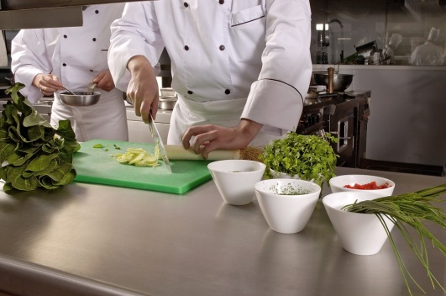
Apply catering control principles and procedures
Use standard recipes correctly:
Purchase required weights
Check yield
Validate results
Update or check pricing prices: every 3 months / 12 months?
Notes:
Trainer to advise:
Following Standard recipes has built it safe guards
Required yields will have a built in reserve
Yield will have built in safe guards
The safe guards will be:
Will all people trim and peel the same amount?
Will they all have the same skill base?
What will be the break even point of multiple people producing the recipe to equal the same result?
If a good cook has a 8% wastage what will an average cook have when they clean meat from carcass 12%
If 10 people did the same job, what is the end result.
Do they all get the same yield; 10 serves at 150gm each serve??????
All these safe guards need to be built into a Standard Recipe.
Also how much have the prices changed

Slide 11
Apply catering control principles and procedures
Implement ordering and stock rotation practices:
Ordering procedures
What is required to prepare menu?
Break done menu items into elements
Example: Bolognese Sauce
Beef mince; pork mince; onion; celery; carrot; garlic; oregano; basil, salt; pepper; vegetable oil; Tomatoes; tomato paste.
Amounts required will depend on standard recipe and how many times this recipe may be required in ordering period.
Notes:
Trainer to advise:
Determining how much stock to order is simple
Standard recipes will produce a set amount of sauce or end product
Remember: it is not just the Bolognese sauce that is required for the menu item
What else??
Chopped parsley for garnish
Parmesan cheese
Pasta
Think of everything
Will it be take away or eat in?
Paper serviettes
Spoon and fork
Container to take product away
Carry bag for container

Slide 12
Apply catering control principles and procedures
Implement ordering and stock rotation practices:
Ordering procedures
Make a stock list for the menu
How many stock items can be used for multiple menu items?
Have all possibilities been thought about?
How much will be required for ordering cycle?
Notes:
Trainer to advise:
Determining how much stock to order is simple
When a completed stock requirement list is completed
Place order
Constant monitoring of stock levels is crucial for smooth operation of any business
Is ‘Par Stock’ system in operation
Is it computerised?
Is it manual? Visual

Slide 13

Apply catering control principles and procedures
Implement ordering and stock rotation practices:
Stock Rotation
New stock arrives
Remove old stock from shelf
Place new product on shelf
Replace old stock in front of new stock
Notes:
Trainer to advise:
Stock rotation is basic
NEVER place new stock in front of old stock when it is placed into the storage area
When new stock arrives:
Remove old stock from storage shelf
Clean down shelf
Place new stock onto storage shelf
Replace old stock onto shelf in front of new stock
Check old stock for out of date or damage

Slide 14
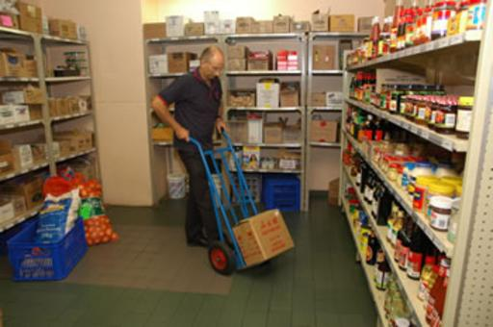
Apply catering control principles and procedures
Use optimum storage procedures:
Fresh Perishable Foods
Below five (5) degrees Celsius: 5°C
Frozen Perishable Foods
Below minus Eighteen (18) degrees Celsius: -18°C
Dry goods
Ambient Temperature (20) Twenty degrees Celsius: 20 °C
Notes:
Trainer to advise:
Fresh foods are best stored below 5 degrees Celsius for up to 3 days
Purchase only what is required and use as soon as possible
Frozen foods need to be stored below -18 degrees Celsius for time period required
Frozen time will vary will all goods but stock should be rotated FIFO for efficient management of stock: Every 3 months; discard stock older than 3 months
Some things can be frozen for longer but if you are carrying stock that has been in your freezer for that length of time then you have lost money

Slide 15
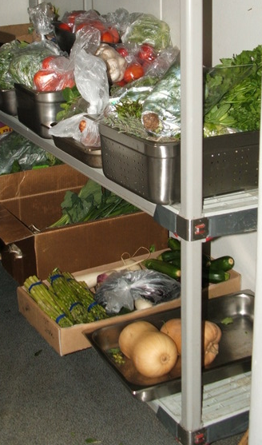
Apply catering control principles and procedures
Use optimum storage procedures:
Fresh Perishable Foods
Below five (5) degrees Celsius: 5°C
3 days
Labeled and wrapped
Notes:
Trainer to advise:
Fresh foods are best purchased as you need them
Some busy hotels need to prepare several days ahead of time just because of the time factor. So processing several days ahead it just using resources more efficiently
Some foods can be stored for longer than 3 days
Failsafe point is 3 days. If fresh food is to be stored then store it for no more than 3 days; this will minimise to possible growth of bacteria to a dangerous level.
If it is kept chilled and protected from contamination (wrapped securely) then it will still be safe for human consumption with minimal risk

Slide 16
Apply catering control principles and procedures
Element 2: Minimise wastage
Use trimmings of food products
Dispose of food wastage in line with enterprise and local authorities’ requirements
Process recyclable products to local authority requirements
Notes:
Trainer to advise:
Trainer to relate performance criteria to element 2
Performance criteria is the process by which the students training match the learning element
The element is the skill
To assess competency in the skill; the performance criteria is used to outline activities that can be used to assess competency.
The trainer should relate how the performance criteria is related to the element
To be able to Apply catering control principles and procedures the students must be able to; Minimise wastage
The student should be able to
Use trimmings of food products
Dispose of food wastage in line with enterprise and local authorities’ requirements
Process recyclable products to local authority requirements

Slide 17
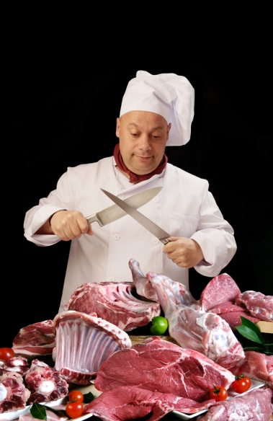
Apply catering control principles and procedures
Use trimmings of food products:
Maximise potential value of all product
Value add
Develop menu flexibility
Notes:
Trainer to advise:
The use of trimmings and off cuts has always been an issue in the commercial kitchen.
The boss or bookkeeper sees all discarded food as potential loss of profit.
Apply total cost of purchases to usable product
Some product has a lot of wastage, some has minimal wastage, some product everything is used.
Sometimes it is NOT cost effective to try and retrieve usable product from trimmings
Sometimes the quality of the trimmings is not sufficient to pay a persons time to retrieve usable product
Skill is required and it is always up to the chef (the one in charge) to decide how the trimmings will be treated and where and how they are to be extracted.
Using trimmings can increase the profit margins if the costs are applied correctly
Menu flexibility can also be improved if the use of the trimmings can be applied.
BUT, sometimes the ‘special dish’ developed to utilise the trimmings become becomes so popular that extra product has to be purchased to meet the popularity of the new menu item.
It is all a balance.

Slide 18
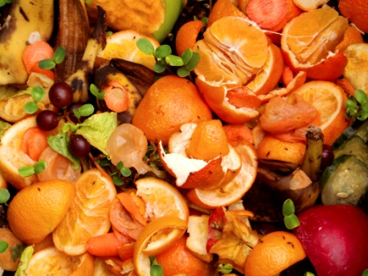
Apply catering control principles and procedures
Dispose of food wastage according to Local Authorities:
Regular disposal is required to reduce built up of smells
Food waste will attract pests
Flies
Rodents
Animals
Notes:
Trainer to advise:
Food waste is a part life.
How it is managed is vital to the safety of the community
Food enterprises have to comply with the rules and regulations of the Local Government Authority
Accumulation of food waste will bring disease and sickness to the community as well as unwanted smells and odours

Slide 19
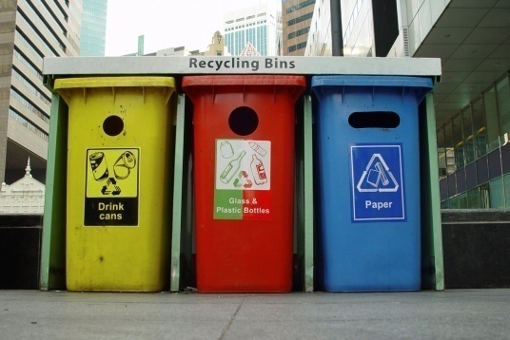
Apply catering control principles and procedures
Process recyclable products to local authority requirements:
Reduce plastic use
Recycle
Reduce possible contamination
Notes:
Trainer to advise:
Recycling is a way of maximising the use of products that otherwise end up as landfill.
Some waste products can poison the land and then contaminate the food chain.
Contamination of the food chain occurs when chemical that come out of plastics and used oils as they begin to breakdown in the soil and these chemical then leach into any foods that are grown in that soil
Contaminated soil is rained upon and the water soaks into the soil and then goes into underground aquifers where ground water is drawn into drinking water
Rain falls onto contaminated soil and runs into the rivers
Taking the plastics and reusing them will reduce the level of soil contamination and leave the soil better suited to producing healthy foods
Metals and glass in the landfill also cause damage
Old cooking oils from deep frying needs to be recycled into detergents or Bio-Diesel, rather than being poured down the sink or being dumped into the soil or water table or river systems
Keep the environment healthy. Recycle.

